Slide 1
Reynolds Consumer Product
13th Jan 2025

Slide 2
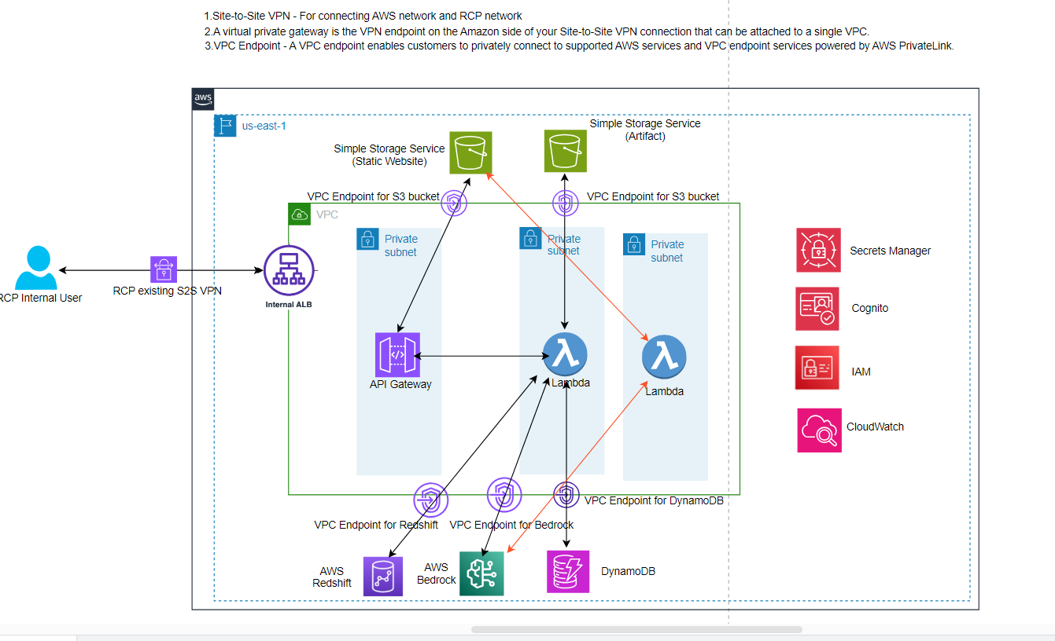
Architecture

Slide 3
RCP
13th Jan 2025

